Slide 1
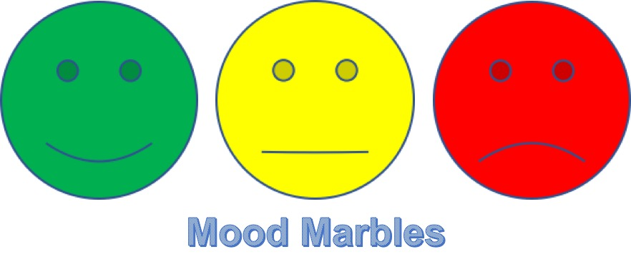
AGILE MOOD MARBLES
An EOSD Italy Market solution

Slide 2
WHAT IS
Is a simple solution developed to support the Agile practice of “mood marble” using Bluemix technology.
Solution can be reached either from a mobile, through an iOS native application and from a web browser at the following address: http://ibm.biz/moodmarbles

Slide 3
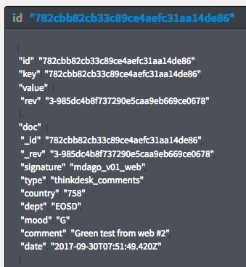
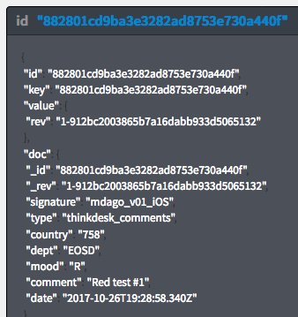
Anonymous
Tool doesn’t store any information related to the user, just the info related to the used client (iOS or Web), so privacy is guaranteed.

Slide 4
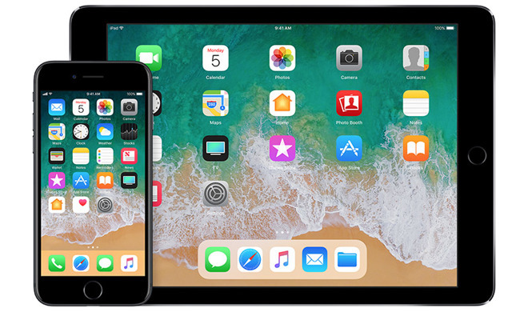




TECHNOLOGY
Back End
Bluemix
Front End
GIT
iOS
Web browser
Node-RED

Slide 5
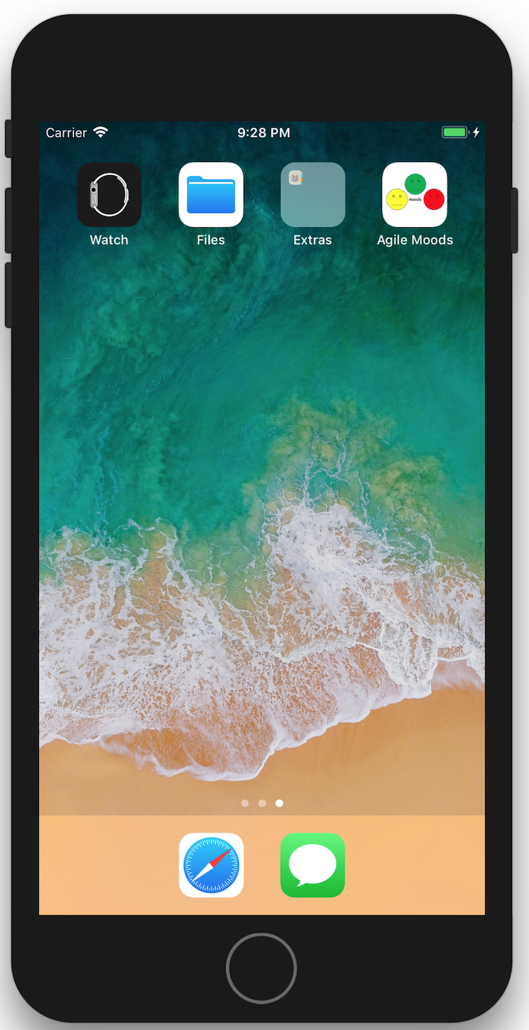
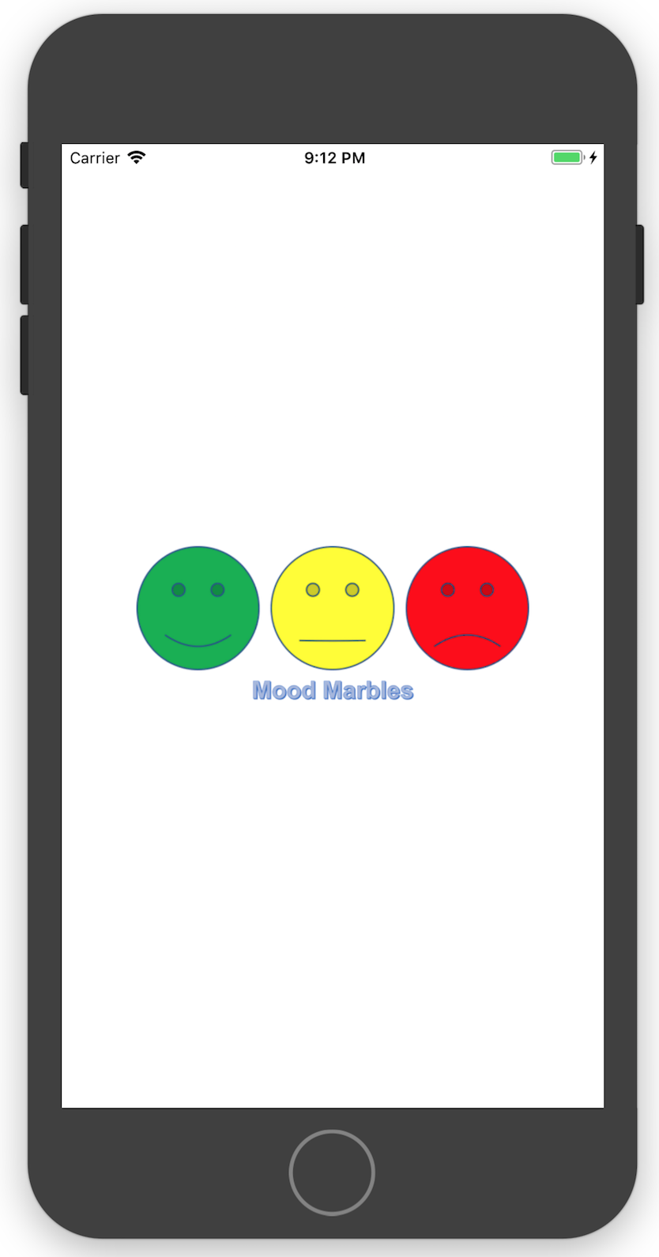
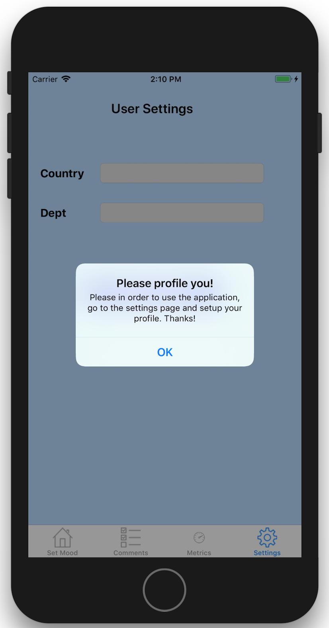
MOBILE SIDE
The mobile version of the app is available only on iOS devices. The first time you launch it, you’ll be requested to profile yourself, by entering the information related to your country (i.e. “758” for Italy) and the Department ID (i.e. “EOSD”).

Slide 6
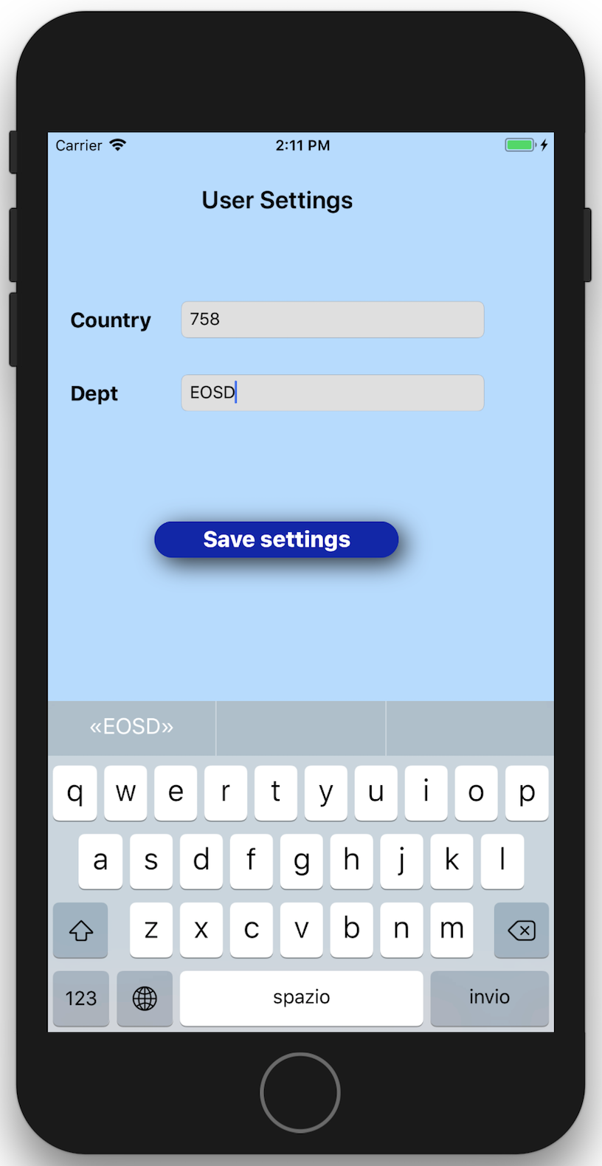
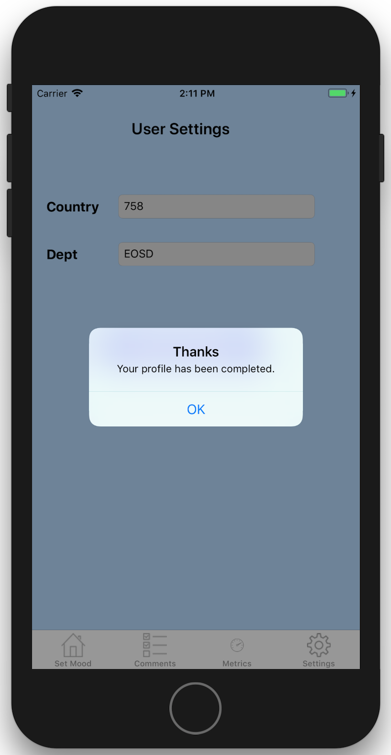
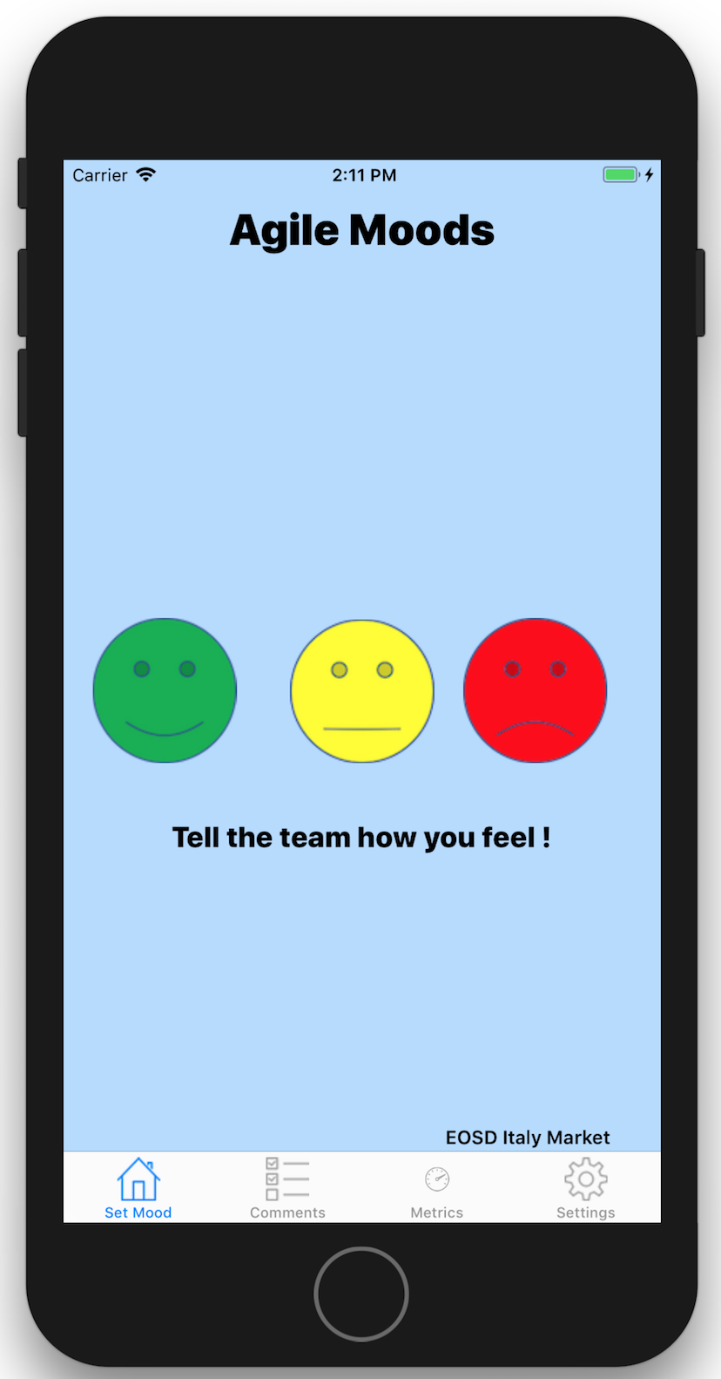
MOBILE SIDE
After having completed the profile registration, you will be able to reach the main page of the app. To register your status, simply click on appropriate smiley.

Slide 7
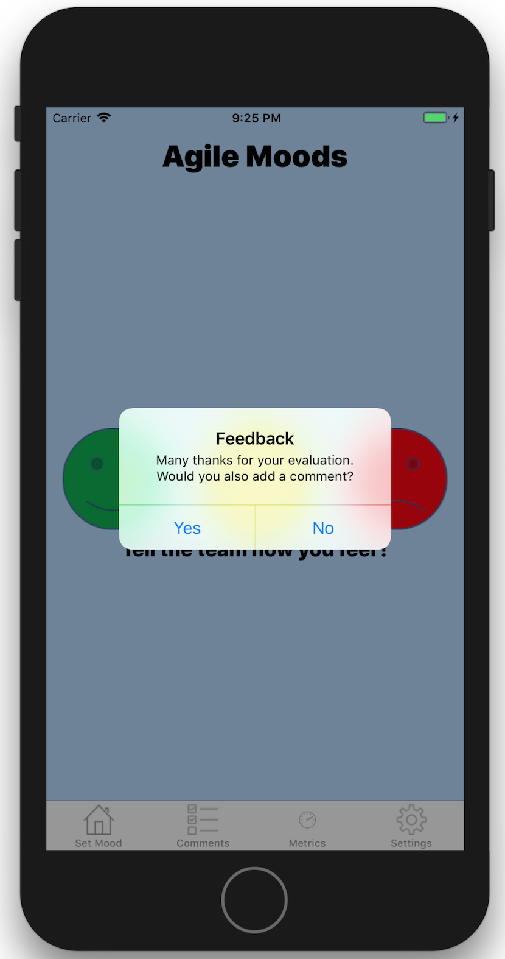
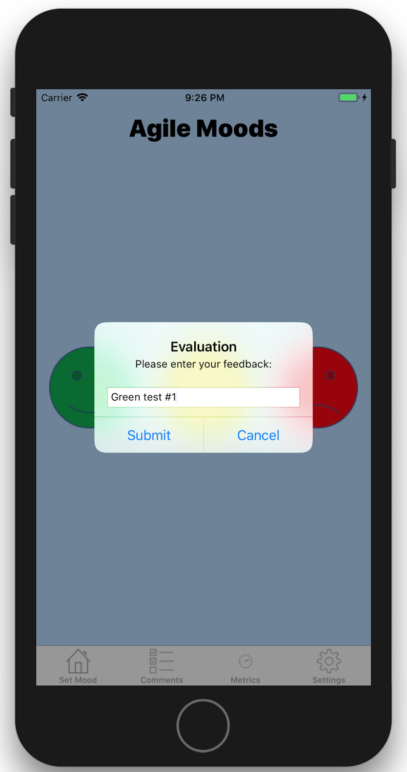
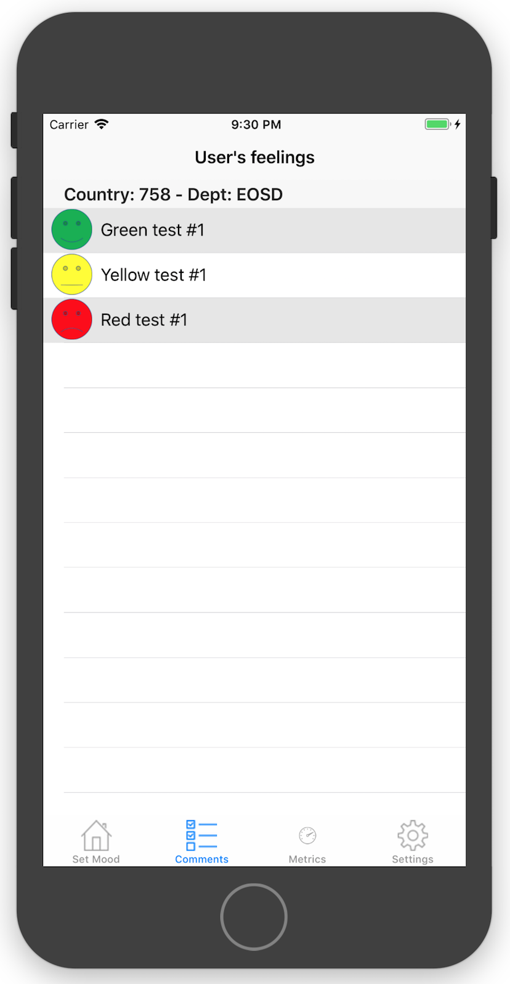
MOBILE SIDE
You can decide to leave or not a comment in support of your feel. The app propose you the choice to do that. In case of acceptance, a prompt will be displayed to register the comment. They are visible on the dedicated tab.
Please note that data are filtered based on the profile parameters (cty/dept.), so each team will see only their records.

Slide 8
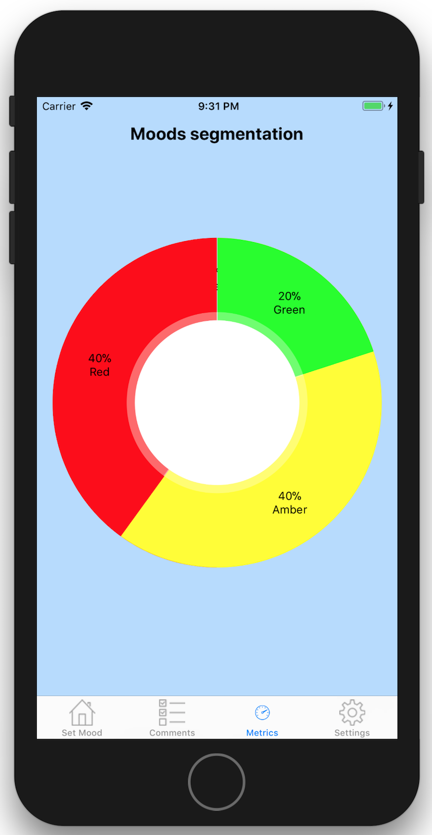
MOBILE SIDE
The tab called “Metrics” provides you with the information related to the overall rating of your team in terms of percentage for each status.
Extracted data are related to the last 30 days, therefore a trend on monthly basis could be put in place.

Slide 9
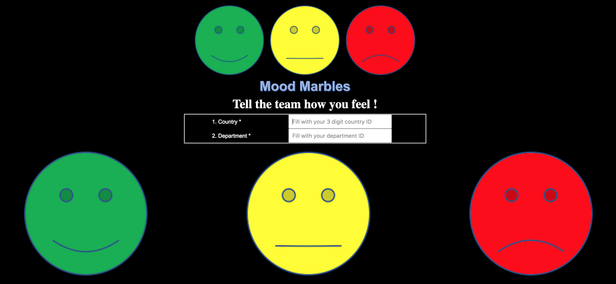
WEB SIDE
In the main page of web app shows you are requested to fill the information related to your country ID (i.e. “758” for Italy) and the Department ID (i.e. “EOSD”).
After that, you can press one of the smileys to register your feeling status.

Slide 10
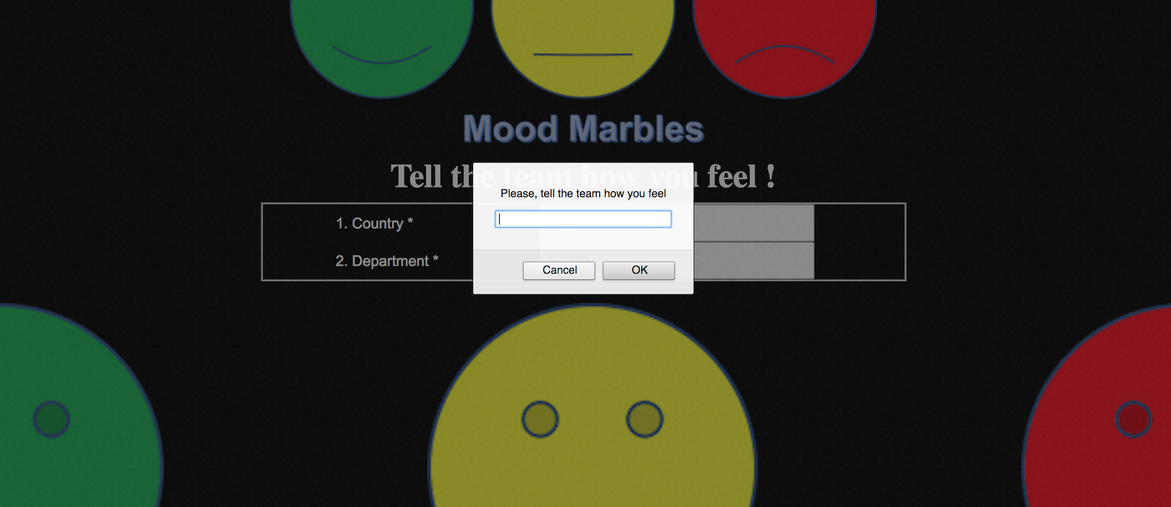
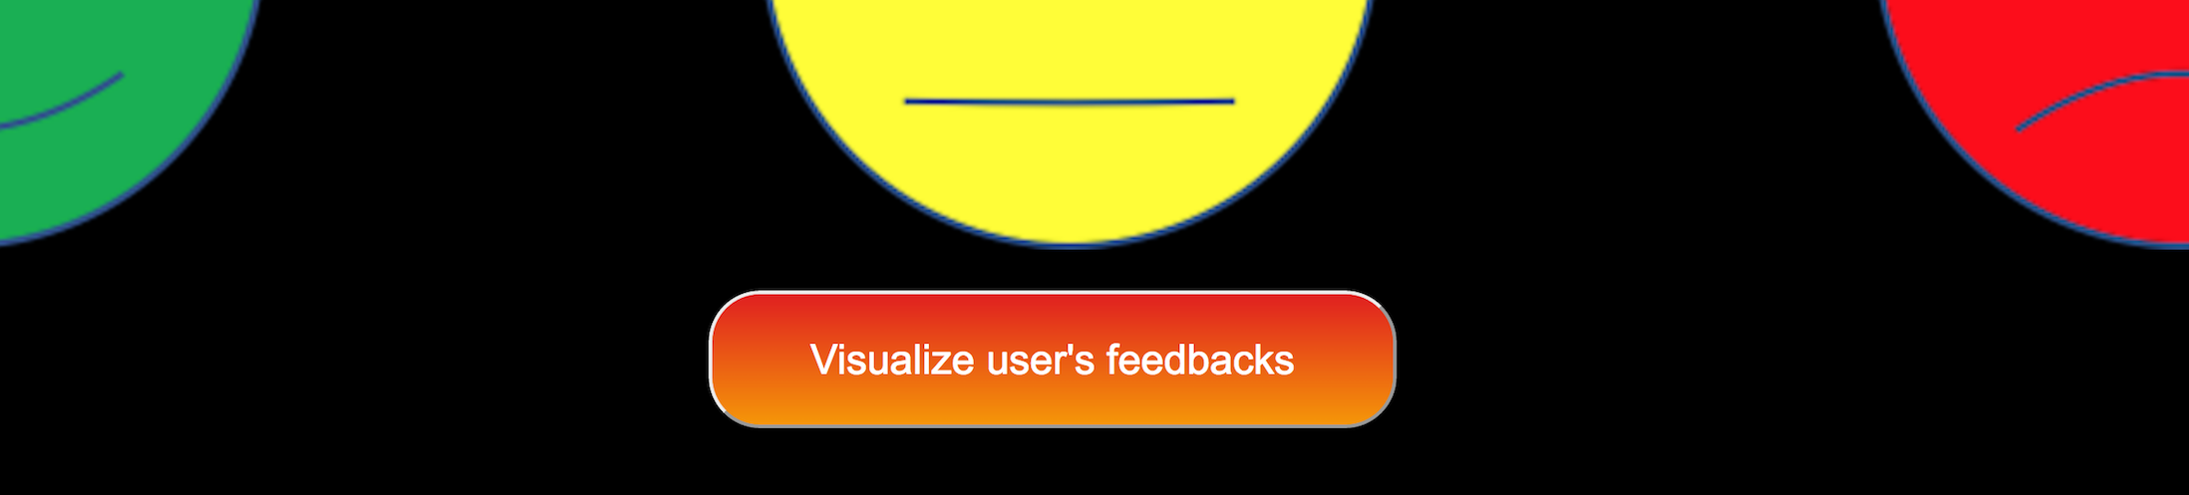
WEB SIDE
You’ll then have the possibility to leave a comment in the prompt issued after having pressed the smiley.
Pressing “OK” you should see a new button appearing on the page: “Visualize user’s feedbacks”. Clicking on it, a new page with metrics will be invoked.

Slide 11
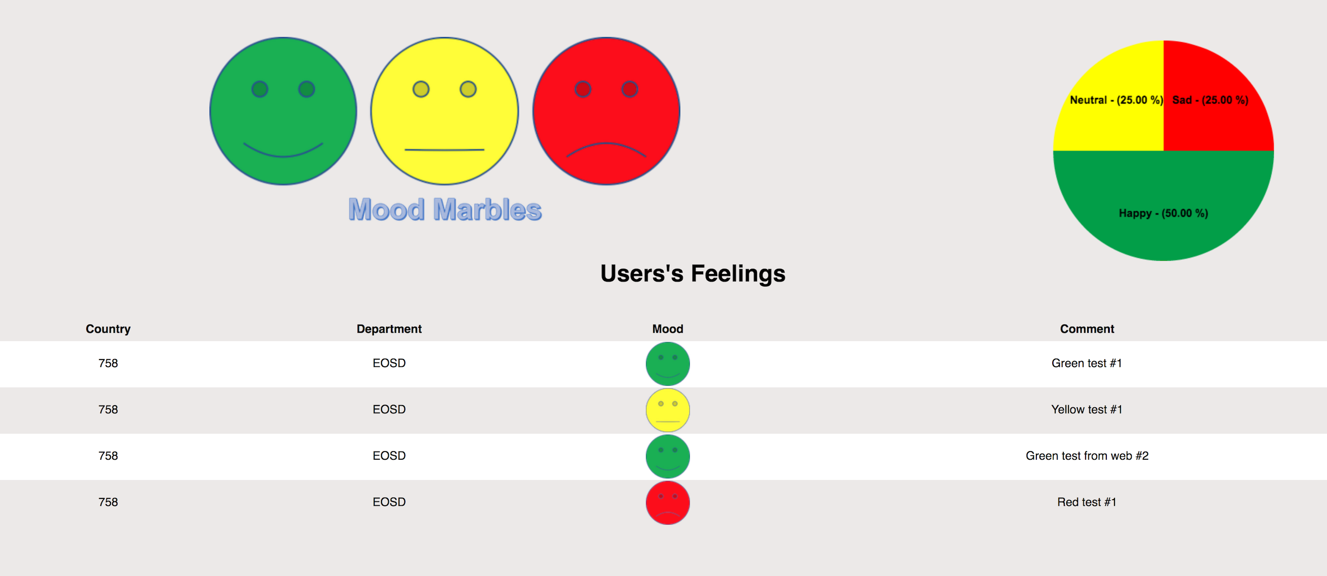
WEB SIDE
Like the mobile app, also on the web side you are able to see your team comments and overall rating.
Extracted data are related to the last 30 days, therefore a trend on monthly basis could be put in place.

Slide 12
Thanks

